Slide 1


Introduction to Research
Prof. Pravin Kumar
Ph.D. (IITD), Operations & Supply Chain Management
Professor, Department of Mechanical Engineering,
Delhi Technological University, Delhi-110042

Slide 2
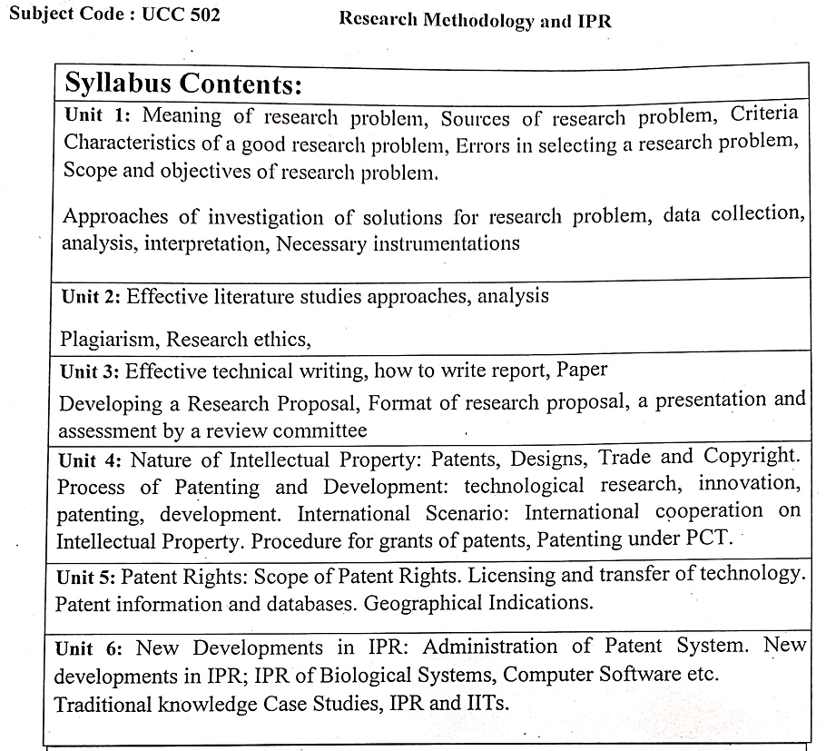
Syllabus

Slide 3
Research Methodology & IPR
Introduction to Research and Research Philosophy
1
Research Onion
Data Collection Methods
Data Collection and Interpretation
Data Analysis and Interpretation
Basic Statistics, z-test, t-test, chi-square test,
Hypothesis testing, parametric and nonparametric testing.correlation and regression,
ANOVA, MANOVA
Literature Review and Paper writing
Literature review, preparation of review paper, Bibliometric Analysis Using Bibexcel, Vosviewer, R-shiny
Intellectual Property Right
Patent, Copyrights, Industrial Design,
Trademark, trade secret, IPR in Software,
Computer and Biotechnology Case studies

Slide 4
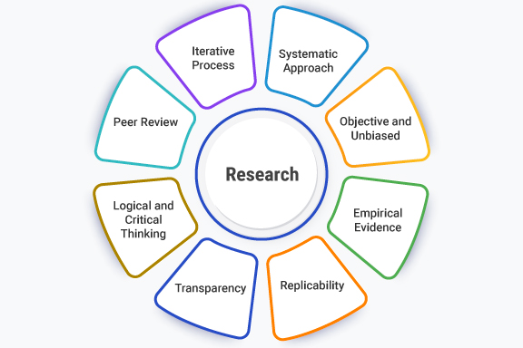
Definition of Research
Research is the process of systematically collecting, analyzing, and interpreting data to create new knowledge or use existing knowledge in a new way.

Slide 5
Research Methods & Methodology
Research methods
refers to techniques and procedures used to obtain and analyse data.
includes questionnaires, observation and interviews as well as both quantitative (statistical) and qualitative (non-statistical) analysis techniques.
The term Research methodology refers to the theory of how research should be undertaken, i.e. the way of conduction the research.

Slide 6
Research Problem
A research problem is
a statement that identifies an issue or area of concern that needs to be investigated.
a condition that needs to be improved, a difficulty that needs to be eliminated,
a question that needs to be answered.
A research problem statement is a key part of the research process, as it guides the entire study.

Slide 7
2
Personal Experience
Practical Experience
Critical Appraisal of Literature
Previous Research
Existing Theories
Consumer feedback
Sources of Research Problems
Performance Improvement Activities
Social Issues
Brainstorming
Intuition
Folklores
Exposure to field situation
Consultation with Experts

Slide 8
Characteristics of Good Research Problems
Characteristics of Research Problems
clear, concise, and specific
explains why the research is important
explains what gaps in knowledge exist
explains what potential implications or applications the research may have.
easily understandable to both experts and non-experts in the field
3

Slide 9
Characteristics of Good Research
Objectivity
Reliability
Validity
Accuracy
Credibility
Generalizability and many more
Empirical Research
Controlled Factors
Replicable
Systematic and Logical
Cyclical

Slide 10


Characteristics of Good Research
Objectivity: Research is supposed to be free from any personal and other sorts of biases, which will make the research error-free as well.
Reliability: Reliability is a characteristic of research that is expected to generate the same results repeatedly, making it consistent.

Slide 11
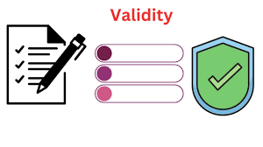

Characteristics of Good Research
Validity: Validity means that the research should be measuring and following the processes which it is expected to do.
Accuracy: Accuracy means the methods and tools of measurement should be ideal.

Slide 12


Characteristics of Good Research
Credibility: The data and techniques used should be the best and most cost-effective.
Generalizability: This means that the research outcome should apply to a much larger population.

Slide 13


Characteristics of Good Research
Empirical Research: This means that research should be based on real-life experiences.
Systematic and Logical: Research should follow systematic steps and techniques based on certain logic.

Slide 14
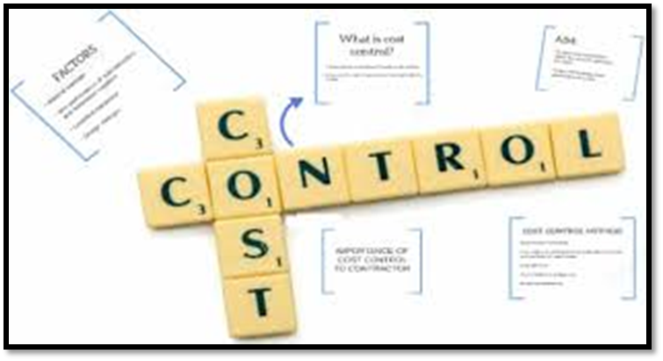
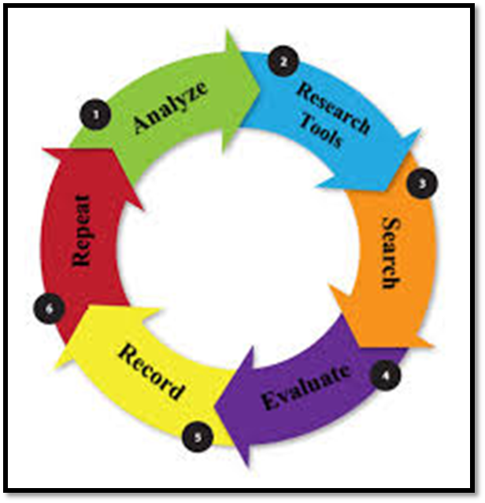
Characteristics of Good Research
Controlled Factors: In every research, certain factors affect the study, but they need to be held while doing research.
Cyclical: Research should be such that it should start with a problem, and there should always be further scope for working on it.

Slide 15

Characteristics of Good Research
Replicable: This means that the same research should give the same results if done by anyone else.

Slide 16
Criteria for selecting a good research problem
4
The researcher should have interest in the problem area.
The selected problem should be of theoretical importance and fill gaps in literature.
Data should be accessible.
Peer recognition of its importance.
The problem should enhance and broaden researchers’ knowledge and skills In research.

Slide 17
Criteria in selecting a good research problem
The research problem should of sufficient magnitude and scope to fulfill the requirements that motivate the study.
The solution to the research problem should be practicable.
The research problem should have enough variables.
It should contribute to the advancement of knowledge
It should meet publication standards.

Slide 18
Errors in Selecting the Research Problems
5
Experimental Error
Interview Studies Error
Material Error
Observational Error
Conceptual Error
Discursive Error
Population specification error
Selection Error
Frame Error
Non Response error
Surrogate Information Error
Measurement Error

Slide 19
Errors in Selecting the Research Problems: Population Specific Error
Population Specific Error: Selection of inappropriate population in place of required population.
Selection Error: Lack of randomness in selecting the sample from population.
Selecting the most accessible and agreeable friends and associates representing the desired population.

Slide 20
Errors in Selecting the Research Problems: Frame Error
Frame Error: Frame error is defined as the discrepancy between the sampling frame used in survey research and the target population it intends to represent.
It occurs when the sampling frame either underrepresents or over represents certain segments of the population, leading to biases in the sample and potentially compromising the generalizability and validity of survey results. .

Slide 21
Errors in Selecting the Research Problems: Frame Error
Non-response Error: Non response error occurs when obtained sample differs rom the original selected sample. This may be
Non Contact due to permanent shifting of respondents from the current location of moved away during the survey period.
Refusal of respondent to respond the particular item. It can be managed by providing proper training to the interviewer and continuous investigation process.

Slide 22
Errors in Selecting the Research Problems: Surrogate Information Error
Surrogate Information Error: It occurs due to
The information collected from substitutes rather than original sample.
This is due to unwillingness or inability of respondents to provide the required information.
Secondary source of the data is surrogate information.
This error can be minimized by ensuring that the information used is highly correlated with actual information obtained/required.

Slide 23
Errors in Selecting the Research Problems: Measurement Error
Measurement Error: It is the difference between the information generated and information required.
It includes errors of incorrect editing, coding and/or descriptive summarization and inferences or the incorrect knowledge drawn from analysis.
Experimental Error: The researcher attempts to measure the impact of one or more manipulated independent variable on some dependent variable while controlling the impact of exogenous variable.
Unfortunately control over all the exogenous variable is not always possible which may lead to an inclusion of bias in the experiments.

Slide 24
Errors in Selecting the Research Problems: Interview Studies Error
Interview Study Error: Not adequately planning the interview
Not conducting sufficient practice interviews to acquire needed skills.
Failing to establish safeguards against interviewer.
Using language in the interview that the respondents won’t understand.
Material Error: Improper material (impure sample, contaminated culture)
Improper procedure (violate experimental protocol, poor technical skill)

Slide 25
Errors in Selecting the Research Problems: Observational Error
Observational Error: Measurement Error (also called Observational Error) is the difference between a measured quantity and its true value. It includes random error (naturally occurring errors that are to be expected with any experiment) andsystematic error (caused by a mis-calibrated instrument that affects allmeasurements)

Slide 26
Errors in Selecting the Research Problems: Observational Error
Conceptual Error: Inappropriate statistical model
Inappropriate specification of model from theory
Wrong assumptions or boundary conditions.
Incomplete theory, lack of alternative explanations

Slide 27
Errors in Selecting the Research Problems
Discursive Error: Communication failures: incomplete reporting, translation hurdles
Public misconception of scientific results and misunderstanding of science (poor science education, poor science journalism, etc.)

Slide 28
Basic Approaches to minimize the errors
6
To minimize research error, use proper, randomized, and stratified sampling techniques to ensure your sample accurately represents the population, increase the sample size to improve accuracy, and carefully design your survey questions and methodology.

Slide 29
Basic Approaches to minimize the errors
Large Sample Size : A larger sample size will get you closer to the true population and reduce the potential for error.
Ensure Representation: Make sure your larger sample includes fair representation of all demographic groups to avoid bias.
Use Appropriate Sampling Techniques:
Random Sampling: Implement a random sampling method, such as simple random sampling, to give every member of the population an equal chance of being chosen for your study.
Stratified Sampling: Divide your population into smaller, meaningful groups (strata) and then sample from each group proportionally to their size in the population.

Slide 30
Basic Approaches to minimize the errors
Systematic Sampling: Select samples systematically by choosing every nth member from a list of the population.
Improve Study Design and Execution
Understand Your Population: Gain a deep understanding of your population's demographics and characteristics to create a representative sample.
Use Representative Samples: Be sure that the sample you select accurately reflects the entire population being studied.
Pilot Testing: Conduct a pilot study to identify potential issues and improve survey questions before the main research begins.

Slide 31
Basic Approaches to minimize the errors
Collaborate with Experts: Work with experienced researchers to understand sampling techniques and methodologies relevant to your project.
Replicate and Validate: If possible, replicate your study to confirm your findings and minimize the effects of individual errors.

Slide 32
Objectives of Research Problems
7
To gain familiarity with a phenomenon or to achieve new insights into it
To portray accurately the characteristics of a particular individual, situation or a group
To determine the frequency with which something occurs or with which it is associated with something else
To test a hypothesis of a causal relationship between variables

Slide 33
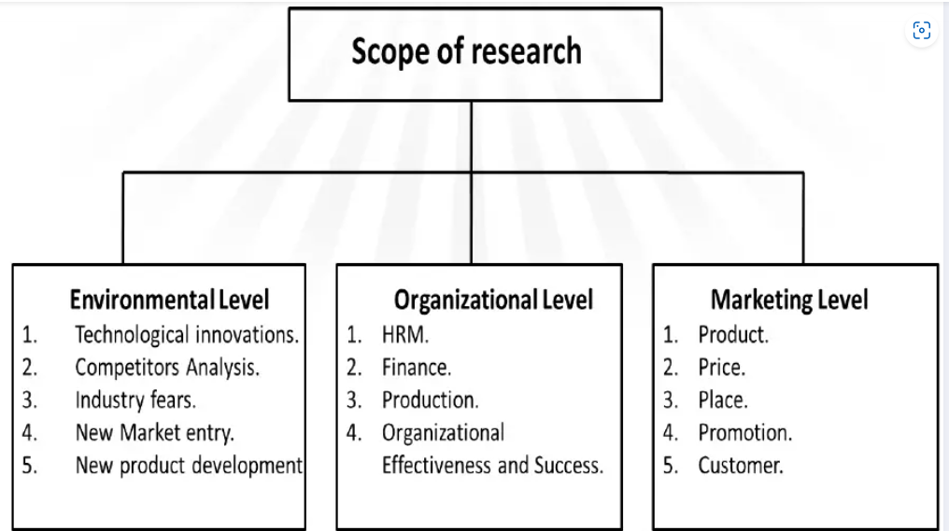
Scope of Research
9

Slide 34


THANKS

